Slide 1
Computer Network
Miss Rabia Qasim

Slide 2
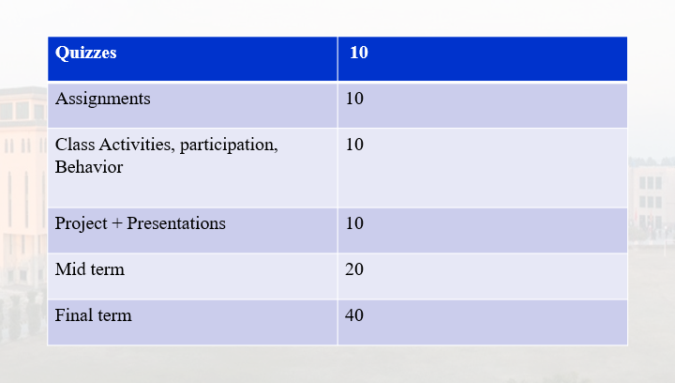
Distribution

Slide 3
Books
Computer Networking, A Top-Down Approach by James F. Kurose
Reference books:
Computer Networking Problems and Solutions & quot; by Russ White and Ethan
Banks
• Network Fundamentals CCNA Exploration Companion Guide, Mark Dye.
• Behrouz A. Forouzan, Data Communications and Networking, Mc-Graw.
• Computer Networks, A system approach, Larry Peterson &amp; Bruce Davie.

Slide 4




Network
A network is a collection of computers and devices connected together via transmission medium or channel for the sharing of the data.
Connections between computing devices can be physical using wires or wireless
Advantages of a network include:
Facilitating
communications
Sharing
hardware
Sharing data
and information
Sharing
software

Slide 5
Network
Node (host)
Any device on a network
Bandwidth
Bandwidth describes the maximum data transfer rate of a network or Internet connection. It measures how much data can be sent over a specific connection in a given amount of time.
For example, a gigabit Ethernet connection has a bandwidth of 1,000 Mbps

Slide 6
Network
Packets
Pieces of data transmitted over a network
Packets are created by sending node
Data is reassembled by receiving node
Packet header
Sending and receiving address

Slide 7
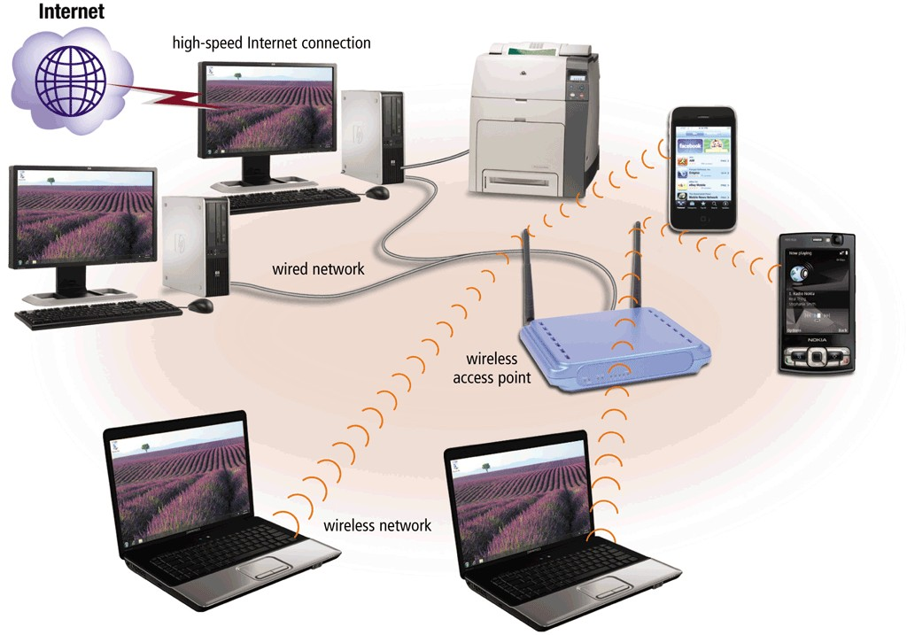
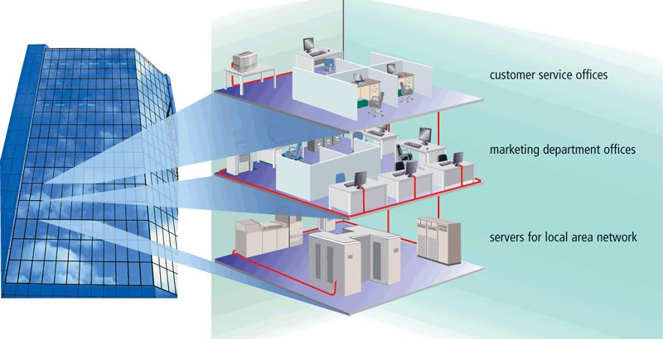
Types of Networks
Local-area network (LAN)
A local area network (LAN) is a network that connects computers and devices in a limited geographical area such as a single building or a college campus
A wireless LAN (WLAN) is a LAN that uses no physical wires

Slide 8
Types of Networks
Local Area Network (LAN)
Systems are close to each other
Contains printers, servers and computers
Organizations often have several LANS
It is usually a privately owned network
LAN’s are easy to design and troubleshoot

Slide 9
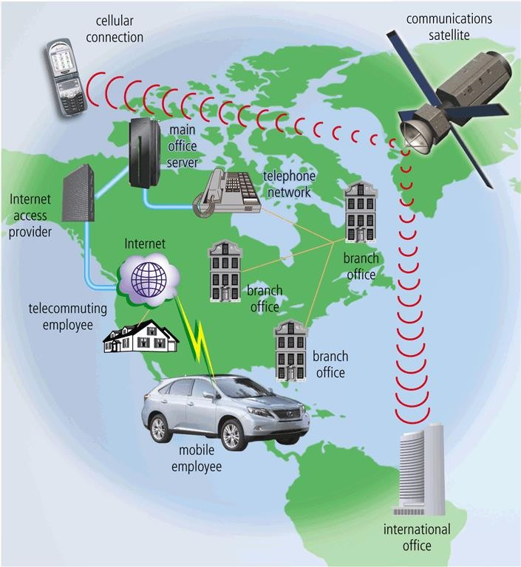
Types of Networks
Wide Area Networks (WAN)
A wide area network (WAN) is a network that connects computers and devices over a large geographic area
The Internet is a WAN

Slide 10
Types of Networks
Wide Area Networks (WAN)
Two or more LANs connected
Over a large geographic area
Computers are at widely separated locations

Slide 11
Types of Networks
Metropolitan Area Network (MAN)
It is in between LAN & WAN technology that covers the entire city.
Large network that connects different organizations
Home Area Network (HAN)
Small scale network
Connects computers and entertainment appliances
Found mainly in the home

Slide 12
Types of Networks
Personal Area Network (PAN)
A personal area network is a computer network organized around an individual person
Very small scale network
Range is less than 2 meters
Cell phones, MP3 players

Slide 13
Network Topologies
Topology
A network topology is the pattern in which nodes are connected to a local area network (LAN) or other network
Choice affects
Network performance
Network size
Several different types
Bus Topology: Single central cable connected a number of devices
Star Topology: Connecting all devices to a central unit
Ring Topology: A number of computers are connected on a closed loop
Mesh Topology: Each device is connected to every other device in the network

Slide 14
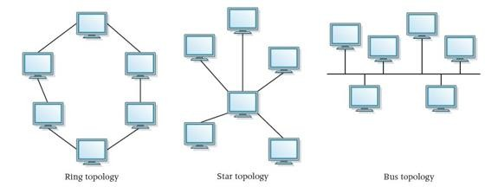
Types of Networks

Slide 15
Network Topologies
Bus topology
One main cable to which all nodes are directly connected
The main cable acts as a backbone for the network
Advantages
Easy and cheap
Small amount of wire
Disadvantages
If the main cable breaks, the entire network goes down

Slide 16
Network Topologies
Star topology
Each computer has a cable connected to a single point
All nodes connect to a hub:
All data must pass through the hub
Hub sends packet to destination
Advantages
Easy to setup
One cable can not crash network
Disadvantages
If hub goes down, entire network down
Uses lots of cable

Slide 17
Network Topologies
Ring topology
Nodes connected in a circle
Data travels in one direction
Tokens used to transmit data
Only the computer who gets the token can send data
Advantages
Reduced chances of data collision as each node release a data packet after receiving the token
Disadvantages
The entire network will be effected if one workstation shuts down

Slide 18
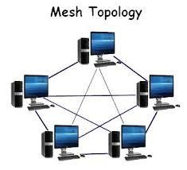
Network Topologies
Advantages of Mesh topology
All computers connected together
Internet is a mesh network
Data will always be delivered
Disadvantages
Lots of cable
Hard to setup

Slide 19
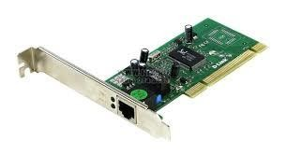
Network Hardware
Network interface cards
Network adapter
Connects node to the media
Unique Machine Access Control (MAC) Address

Slide 20
Network Hardware
Hubs
A device that is used to connect several computers to form a network
A hub has several ports. The number generally is 8, 12, 16, 24,
32, or 48
Center of a star network
All nodes receive transmitted packets
Slow and insecure
Switches
Replacement for hubs
Only particular node receives transmission
Fast and secure
Both: Hubs broadcast data to all devices, switches forward data based on MAC addresses

Slide 21
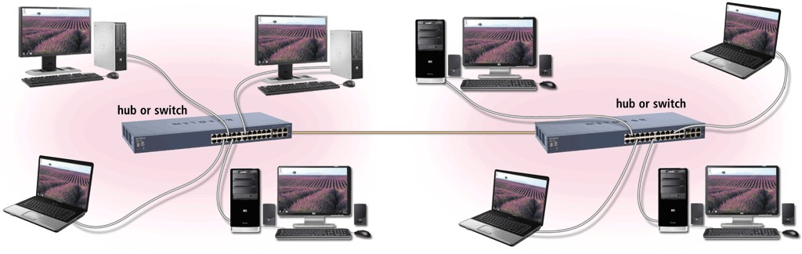
Network Hardware
A hub or switch connects several devices in a network together

Slide 22
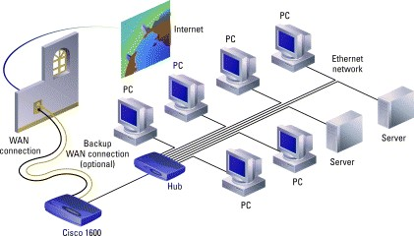
Network Hardware
Router
A router is a device that forwards data packets along networks.
Routers connect different networks and route data packets between them based on IP addresses.

Slide 23
Types of communication
According to data direction
Simplex
One-way communication (only send or only receive)
Half-Duplex
Two-way communication (send/receive) but one at a time
Full Duplex
Two-way communication (send/receive) at the same time

Slide 24
Types of communication
According to recipients
Unicast
Sending data to only one recipient
Multicast
Sending data to multiple recipients
Broadcast
Sending data to everybody

Slide 25
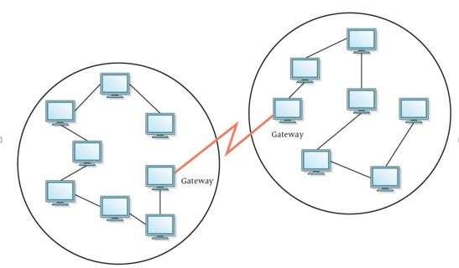
Gateway
A gateway is a networking device that connects two dissimilar networks, translating protocols to facilitate communication, typically serving as an entry and exit point for data between networks.
14

